Slide 1
Least Squares Natural Migration (LSNM) of Surface Waves
Zhaolun Liu
2015.12.9

Slide 2
Outline
Introduction
Theory
Numerical tests
Conclusion
Next works

Slide 3
Outline
Introduction
Theory
Numerical tests
Conclusion
Next works

Slide 4
Introduction
suffers migration artifacts due to the recording geometry and the non-uniform illumination (AlTheyab et.al, 2015).
Least squares method to solve Lm=d
$\text{Natural} \text{migration}\text{ (}\text{NM}\text{)}:$
$m=L^{†}d$, where $L=\sum_{ω,s,g}{ω^{2}\left.G_{0}(r_{g},ω|r\right)\left.G_{0}(r,ω|r_{s}\right)}$
$$m={\left(L^{†}L\right)}^{−1}L^{†}d$$

Slide 5
Outline
Introduction
Theory
Numerical tests
Conclusion
Next works

Slide 6
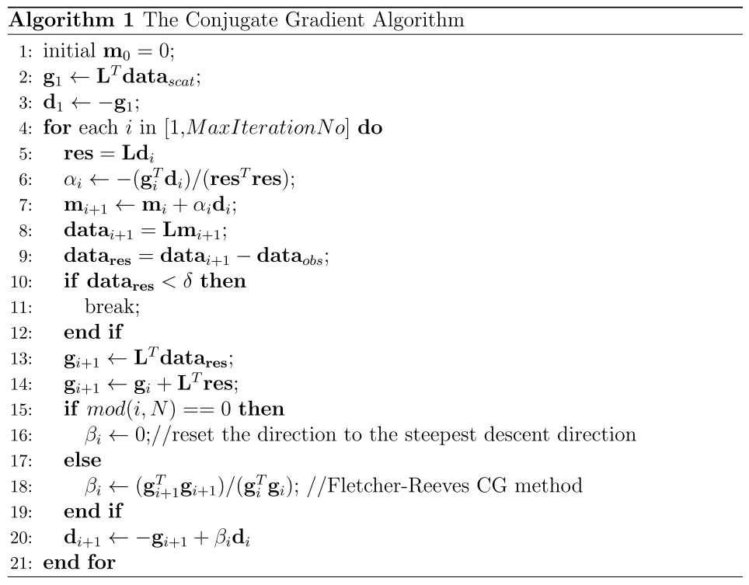
Theory
Iterative method:
Inverse of Hessian method
$$H {(r,r′)=L}^{†}L=\sum_{ω,s,g}{ω^{4}\left.G_{0}^{†}(r_{g}|r\right)\left.G_{0}^{†}(r|r_{s}\right)\left.G_{0}(r_{g}|r‘\right)\left.G_{0}(r’|r_{s}\right)}$$
SVD
$H=UWV^{†}$
pinv$H=VW^{†}U^{†}$, where $W^{†}$ is pseudoinverse of W
$m={\left(L^{†}L\right)}^{−1}L^{†}d$=pinvH${ L}^{†}d$
CG method to solve$Hm=L^{†}d$
1 migration
1st : modeling
2nd : modeling
3rd : migration

Slide 7
Outline
Introduction
Theory
Numerical tests
Conclusion
Next works

Slide 8
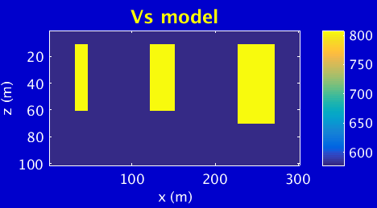
Numerical tests
Six corners model
Pre-processing
Mute the scattered waves to obtain the $G_{trans}$
Mute the transmitted waves to obtain the $d_{scat}$
Natural migration
Calculate the kernel: $L(r_{g}|r|r_{s})=\sum_{ω,s,g}{\left.ω^{2}\left.G_{trans}(r_{g}|r,ω\right)G_{trans}(r|r_{s},ω\right)}$
Calculate the migration image for each shot:$m(r_{s},r)=\sum_{ω, g}{L^{†}(r_{g}|r|r_{s},ω)d(r_{g}|r_{s},ω) }$
Stack the image$m(s,r)$ of all shots: $m_{stack}(r)=\sum_{s}{m(r_{s},r) }$
x3
x5
x1
x2
x4
x6
301 receivers
301 sources
1 m spacing
Dominant fre: 10 Hz
Buried corners locations:
x1=32 m, x2=46 m
x3=122 m, x4=151 m
x5=227 m, x6=271 m
All depth is 10 m

Slide 9
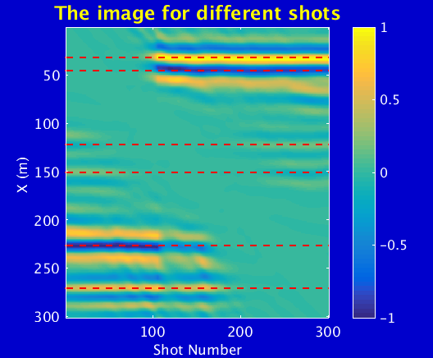
Nature Migration image
Problem 1: the polarity for the fault is different.
Problem 2: the weak energy at the middle.

Slide 10
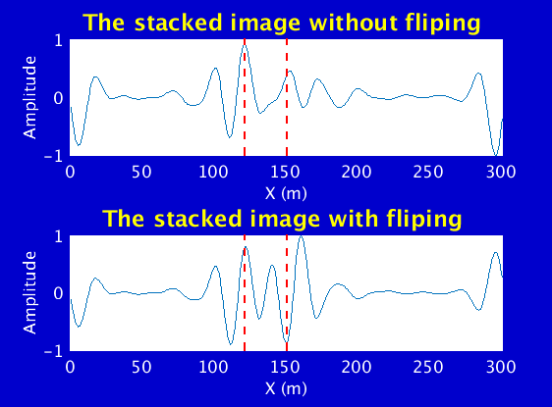
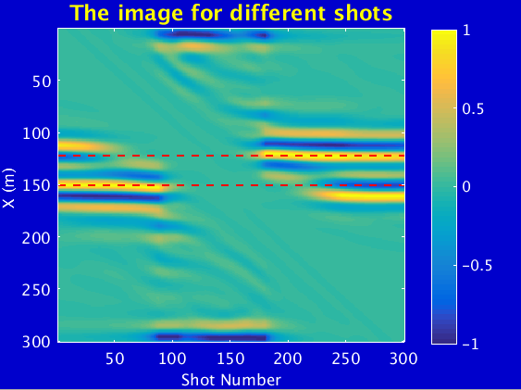
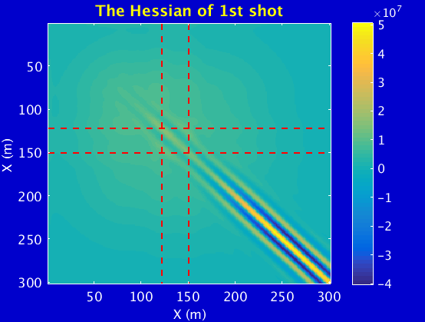
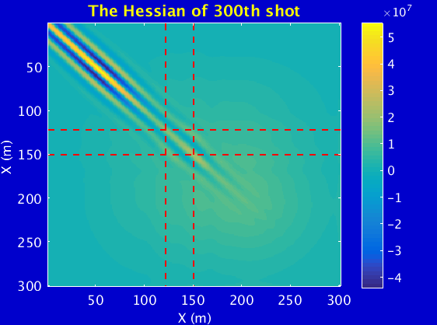
Analysis for two-corner model
x1
x2
Buried corners locations:
x1=122 m, x2=151 m

Slide 11
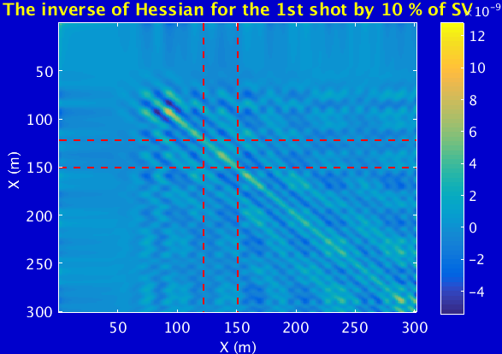
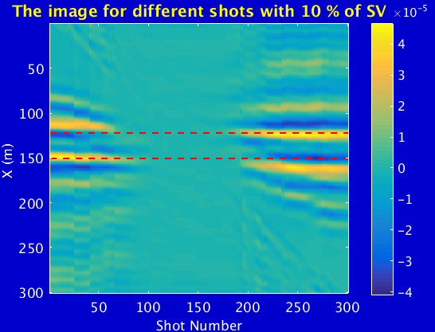
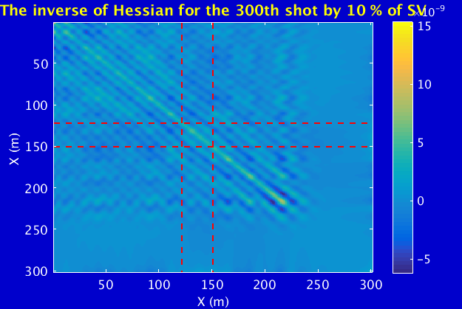
Analysis for two-corner model

Slide 12
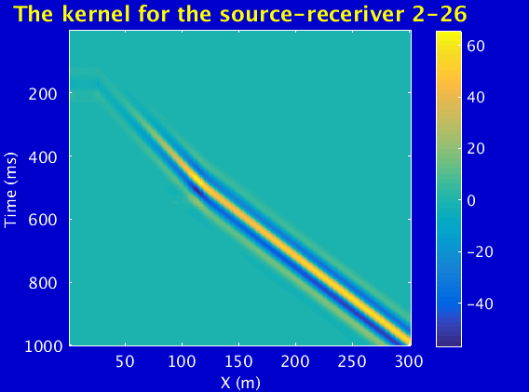
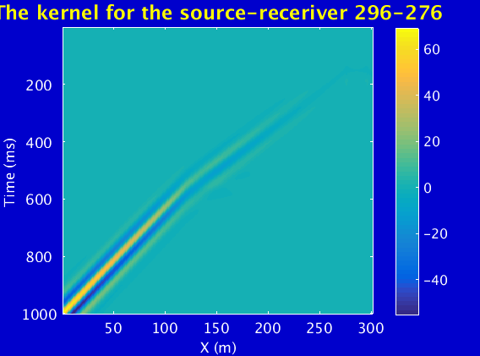
Polarity analysis
One corner model
Calculate the kernel
$$x_{s1}$$
$$x_{g1}$$
$$x_{g2}$$
$$x_{s2}$$
$$x_{s1}$$
$$x_{g1}$$
$$x_{r}$$
$$G_{trans}(x_{r}|x_{g1},t)$$
$$∗$$
$$G_{trans}(x_{r}|x_{s1},t)$$
$$=$$
$$L(x_{r},t)$$
Two source-receiver pairs:
$x_{s1}=2 m$, $x_{g1}=26 m$
$x_{s2}=296 m$, $x_{g2}=276 m$
Buried corners locations:$x_{r}$=122 m

Slide 13
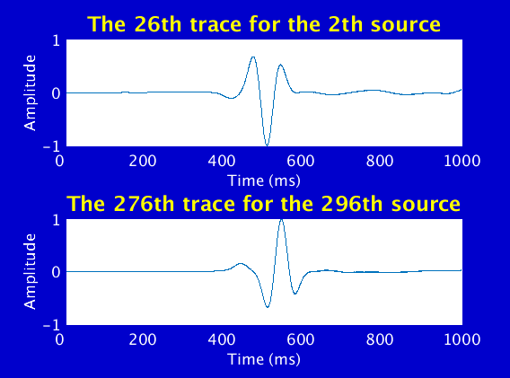
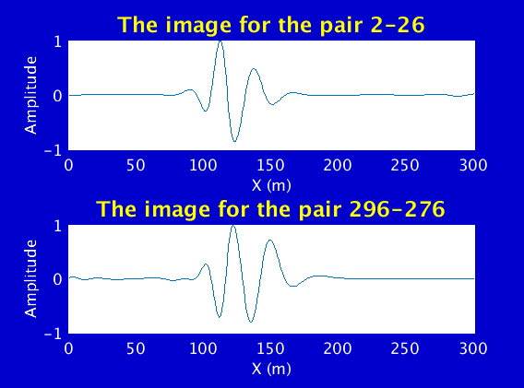
Polarity analysis
Obtain the data (only backscattered waves)
Calculate the image
$$x_{s1}$$
$$x_{g1}$$
$$x_{r}$$
$$m\left(x_{r}\right)=\int{L\left(x_{g1}{\left|x_{r}\right|x}_{s1},t\right)d\left(x_{g1}{|x}_{s1},t\right)dt}$$
$$d(x_{g1}{|x}_{s1},t)$$
$$∙$$
$$=$$
Velocity discontinuity polarity change?
$$∙$$
$$=$$

Slide 14
Energy analysis
For one source and all the receivers
$$x_{s1}$$
$$x_{g1}$$
$$x_{r}$$
$$x_{r1}$$
$$d(x_{g1}{|x}_{s1},t)$$
$$x_{r}$$
$$x_{r1}$$

Slide 15
Migration image of six-corner model
Change polarity at one side of the source
Still too weak at the middle, and how to improve?
Then stack the images of all the shots

Slide 16
The inverse of Hessian
Six-corner model
The energy is balanced!

Slide 17
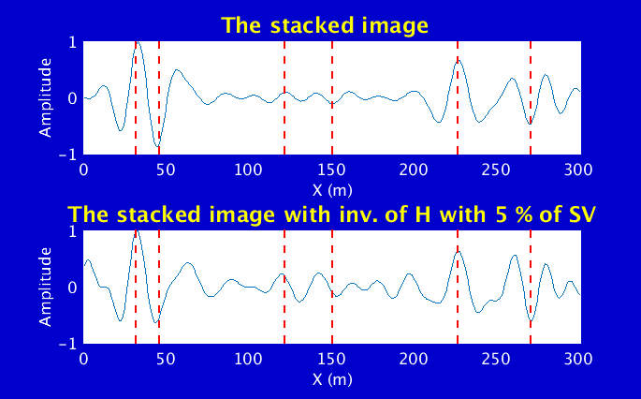
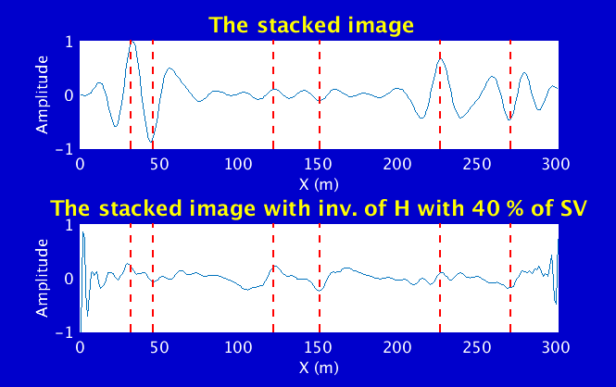
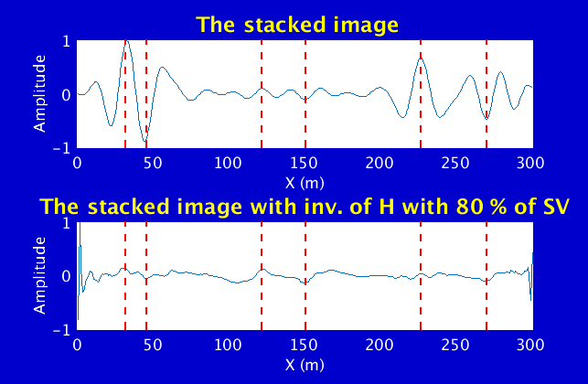
The inverse of Hessian
The stacked images with different number of singular values (SV)

Slide 18
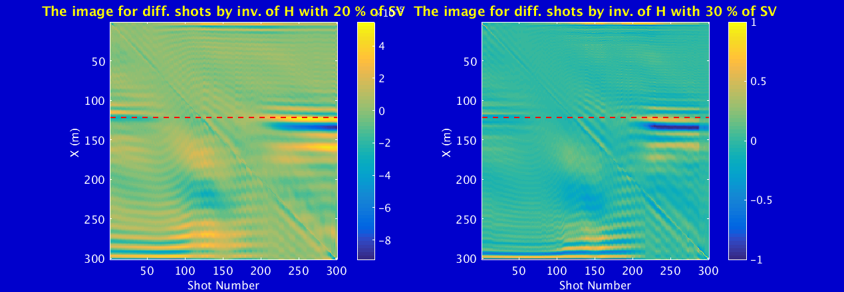
The inverse of Hessian
One corner model

Slide 19
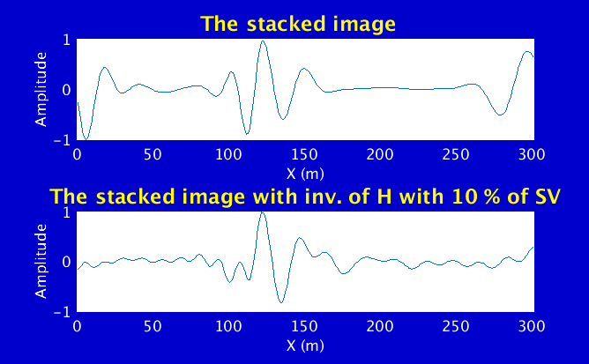
The inverse of Hessian
The stacked images with different number of SVs

Slide 20
Outline
Introduction
Theory
Numerical tests
Conclusion
Next works

Slide 21
Conclusion
For a one-corner fault at near surface, the polarities of the corresponding image of NM with source-receiver at two sides of the fault are opposite.
The energy of one-shot NM images for different buried one-corner faults at the same depth depends on the distance between the position of source and fault.
The inverse of Hessian can balance the energy of NM image to some extent.

Slide 22
Outline
Introduction
Theory
Numerical tests
Conclusion
Next works

Slide 23
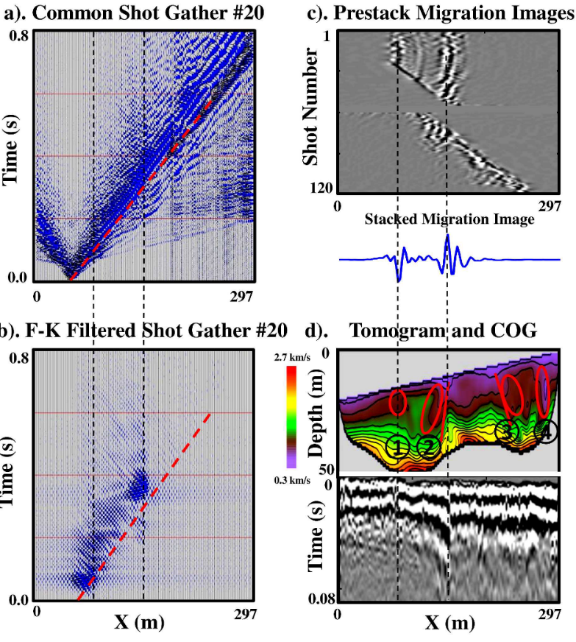
Next works
Apply LSNM to the Aqaba seismic data.
Apply LSNM to 3D problem and analyze the polarity and image energy.
Applying this method to USArray data.
(Han Yu et.al, 2014)

